Slide 1
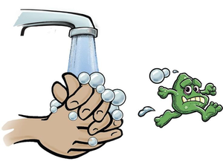
Hand Sanitizer Dispenser Using IOT

Slide 2

Overview
Problem statement
Proposed System
Hardware and Software Requirements
Block Diagram
Gantt chart
Implementation Details
Snapshots
Demonstration
Limitations
Conclusion
References

Slide 3

Problem statement
As human know that COVID-19 disease is spreading wildly and our government and doctors are telling us that we can avoid this disease by washing hands regularly.
In this current scenario of Global Outbreak, It is advised by WHO (World Health Organization) to maintain Healthy Hand Wash and Sanitation Habits, but the main problem is the way people do it,
mankind always have to physically touch the hand sanitizer bottle to wash their hands, which can be a trouble in this pandemic situation,
The covid-19 virus can stick on surfaces and unknowingly people might get effected just because of their sanitizer bottle as they are touching it every time you come from outside.

Slide 4

Proposed System
Hand sanitizer dispenser is implemented to provide safety to mankind.
The term would help people by making them not to touch the sanitizer bottle or similar object.
The hand sanitizer dispenser mainly consists of very basic bottle,arduino,DC water pump(5v) with pipe and ultrasonic sensor.
When people place their hand in front of the ultrasonic sensor, it will indicate to the Arduino to measure the distance from the object (here the hand).
If the object(hand) is in the desired range, Arduino would turn the pump on.
So, Like this way Hand sanitizer dispenser would prevent the chances of getting corona virus by humans.

Slide 5

Hardware and Software Requirements
Hardware Requirements :-
1.Arduino UNO Microcontroller Or Arduino Nano
2.Bread board(Mini)
3.Jumper wires
4.DC Water pump(5v)
5.Ultrasonic sensor
6.Relay
Software Requirements :-
1.Arduino IDE

Slide 6
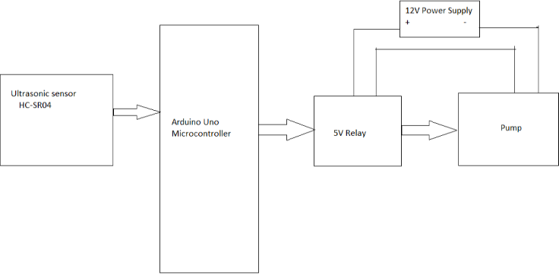
Block Diagram
Figure-1 Block Diagram

Slide 7
Hand Sanitizer Dispenser Gantt Chart

Slide 8
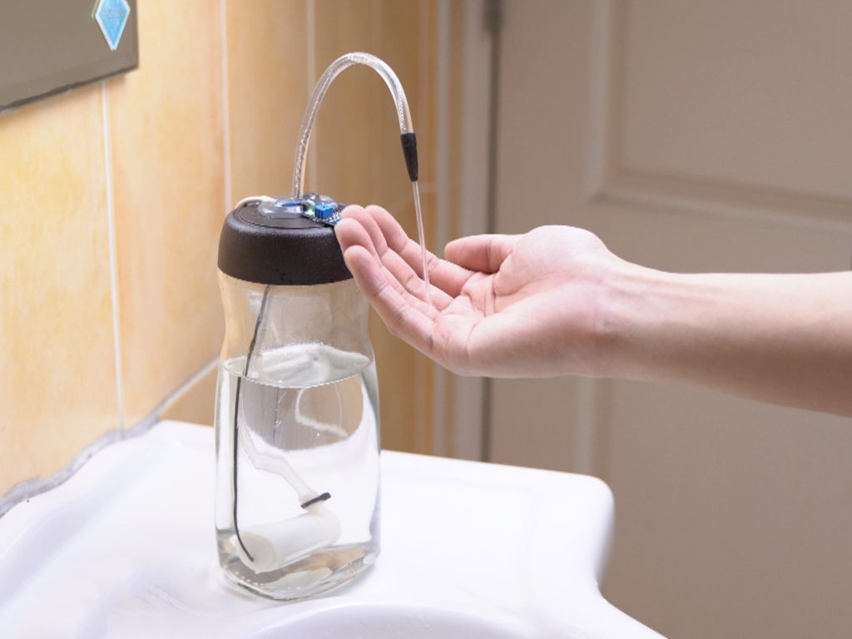
Implementation Details
First and the most important thing that would be needed for this build is Alcohol Based Hand Rub or Hand Sanitizer bottle suggested by W.H.O. ( world health organization )
The bottle would be having pipe and water pump within it and the pump would be directly connected to arduino UNO.
The ultrasonic sensor (which would sense the hand movements) will be directly connected to arduino UNO.
Whenever the hand would come close to the bottle the ultrasonic sensor would immediately sense it and arduino would start the DC pump and By that, sanitizer would come out from pipe(which is connected to pump) and will serve it to human’s hands.
When there is no movement detected by ultrasonic sensor the pump would remain off.

Slide 9
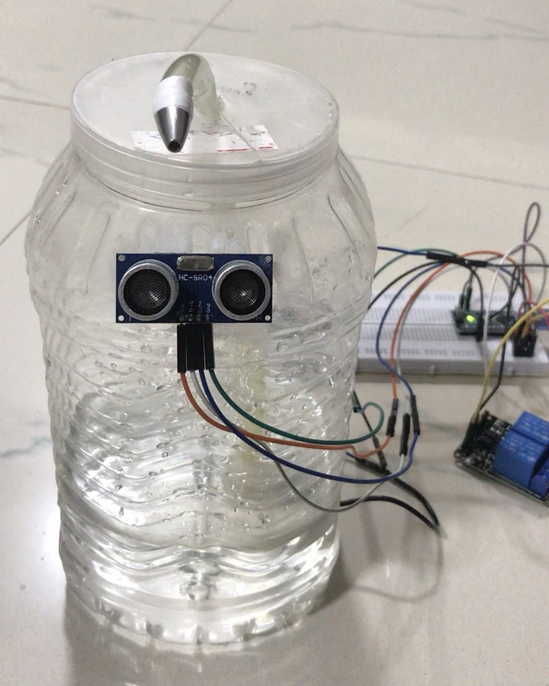
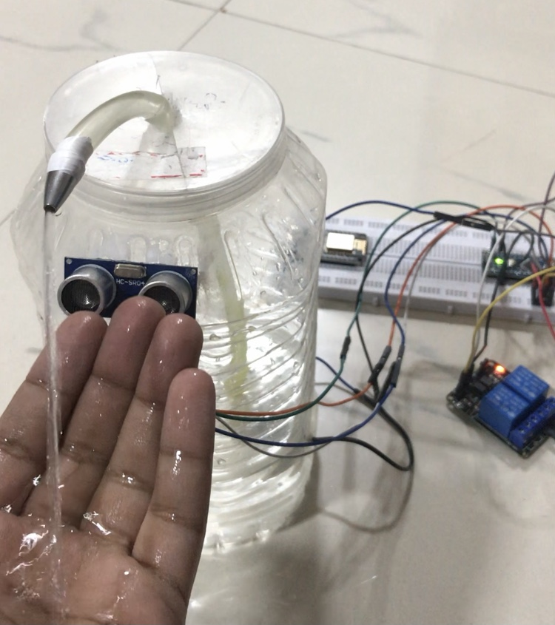
Snapshots
Figure-2 Idle position
Figure-3 After Hand Detection

Slide 10
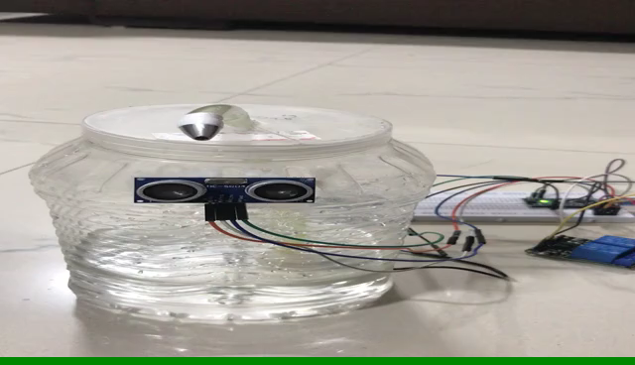
Demonstration
Video-1 Demonstration

Slide 11

Limitations
It needs low power supply. Without it will not work.
Sensor needs to be changed if there is problem in it.

Slide 12

Conclusion
Using hand sanitizer and wearing mask are two most important precautionary steps that should be taken by mankind.
The term Hand sanitizer dispenser would help people from touching the sanitizer bottle for sanitizations purposes.
It would help people to secure their life more to fight against corona virus.
Even touching simple sanitizer bottle could be so harmful to people that’s why this project is best fit for it.
Hence, The Hand sanitizer dispenser would save the people life from the dangerous virus corona and will make people healthy and safe in this crucial time as well as in future.

Slide 13

References
https://robu.in/automatic-hand-sanitizer-dispenser-using-arduino/
https://create.arduino.cc/projecthub/MissionCritical/diy-hand-sanitizer-dispenser-using-arduino-143de1
https://create.arduino.cc/projecthub/akshayjoseph666/covid-19-automatic-hand-sanitizer-78cf6b
https://techatronic.com/how-to-make-automatic-hand-sanitizer-using-arduino/

Slide 14


